Slide 1
Update: Piezo-energy harvesting
Chongan Wang
2025-01-31

Slide 2
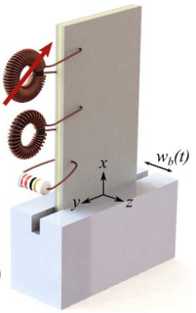
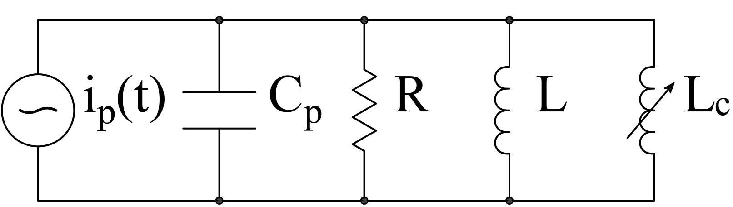






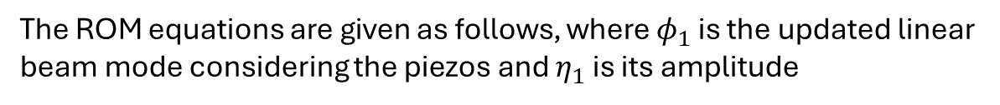

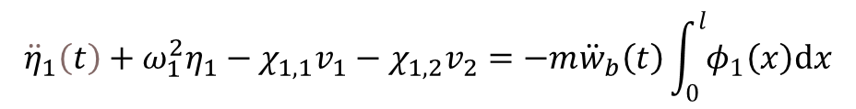

Analytical Foundation – a Review
The current structural damping of the beam is 0
The ROM equations are given as follows, where $φ_{1}$ is the updated linear beam mode considering the piezos and $η_{1}$ is its amplitude
$$x=l$$
$$v\left(t\right)$$
$${\ddot{η}}_{1}\left(t\right)+ω_{1}^{2}η_{1}−χ_{1,1}v_{1}−χ_{1,2}v_{2}=−m{\ddot{w}}_{b}\left(t\right)\int_{0}^{l}{φ_{1}\left(x\right)dx}$$
Beam:
$$C_{p}\frac{dv_{1}\left(t\right)}{dt}+\frac{v_{1}\left(t\right)}{R_{1}}+κ_{1,1}\frac{dη_{1}}{dt}=0$$
$$x=\frac{l}{2}$$
Harvester:
$$C_{p}\frac{dv_{2}\left(t\right)}{dt}+θ\int_{0}^{l}{\frac{∂^{3}w}{∂x^{2}∂t}dx}=i_{2}\left(t\right)$$
Modulator:
Harvesting power: $P_{1}=v_{1}^{2}/R_{1}$
Modulating power: $P_{2}=v_{2}i_{2}$
We note that $v_{2}$ and $w_{b}$ are prescribed

Slide 3
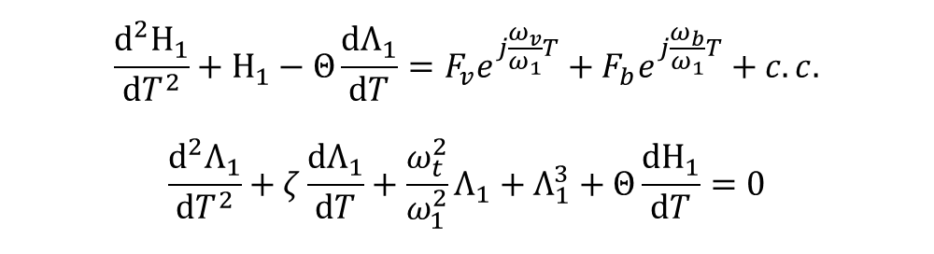
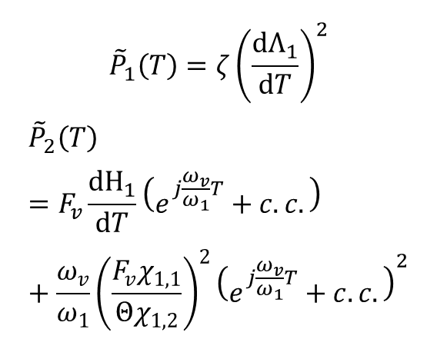
Power Flow
The current structural damping of the beam is 0
$$x=l$$
$$\frac{d^{2}Η_{1}}{dT^{2}}+Η_{1}−Θ\frac{dΛ_{1}}{dT}=F_{v}e^{j\frac{ω_{v}}{ω_{1}}T}+F_{b}e^{j\frac{ω_{b}}{ω_{1}}T}+c.c.$$
$$\frac{d^{2}Λ_{1}}{dT^{2}}+ζ\frac{dΛ_{1}}{dT}+\frac{ω_{t}^{2}}{ω_{1}^{2}}Λ_{1}+Λ_{1}^{3}+Θ\frac{dΗ_{1}}{dT}=0$$
$$v\left(t\right)$$
We consider the previous simulation case
$$x=\frac{l}{2}$$
$${\tilde{P}}_{1}\left(T\right)=ζ{\left(\frac{dΛ_{1}}{dT}\right)}^{2}$$
$${\tilde{P}}_{2}\left(T\right)=F_{v}\frac{dΗ_{1}}{dT}\left(e^{j\frac{ω_{v}}{ω_{1}}T}+c.c.\right)+\frac{ω_{v}}{ω_{1}}{\left(\frac{F_{v}χ_{1,1}}{Θχ_{1,2}}\right)}^{2}{\left(e^{j\frac{ω_{v}}{ω_{1}}T}+c.c.\right)}^{2}$$

Slide 4

The flux linkage response to base excitation
As we update the ROM, the hysteresis is slightly modified
0.0036
0.0037
0.0171
0.0187
Old hysteresis
Updated hysteresis
Force: $F_{v}e^{j\frac{ω_{v}}{ω_{1}}T}+F_{b}e^{j\frac{ω_{b}}{ω_{1}}T}+c.c.$
Previous simulation case: $F_{b}=−0.0155$; $F_{v}=0.039e^{iπ/2}$

Slide 5
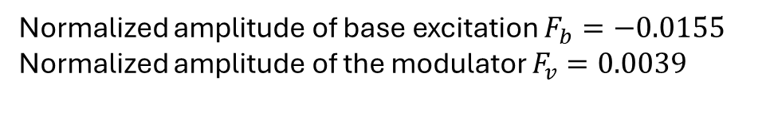
The flux linkage response to base excitation
Frequency of modulator: 501rad/s
Frequency of base excitation: 500rad/s
Natural frequency of the first mode: 570rad/s
Normalized amplitude of base excitation $F_{b}=−0.0155$
Normalized amplitude of the modulator $F_{v}=0.0039$

Slide 6
The flux linkage response to base excitation
Frequency of modulator: 503rad/s
Frequency of base excitation: 500rad/s
Natural frequency of the first mode: 570rad/s
Normalized amplitude of base excitation $F_{b}=−0.0155$
Normalized amplitude of the modulator $F_{v}=0.0039$

Slide 7
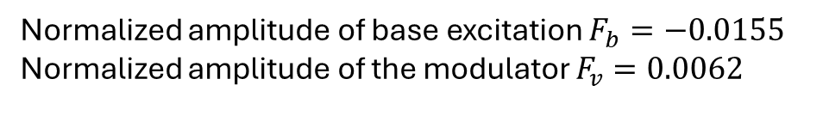
The flux linkage response to base excitation
Frequency of modulator: 503rad/s
Frequency of base excitation: 500rad/s
Natural frequency of the first mode: 570rad/s
Normalized amplitude of base excitation $F_{b}=−0.0155$
Normalized amplitude of the modulator $F_{v}=0.0062$

Slide 8
The flux linkage response to base excitation
Frequency of modulator: 505rad/s
Frequency of base excitation: 500rad/s
Natural frequency of the first mode: 570rad/s
Normalized amplitude of base excitation $F_{b}=−0.0155$
Normalized amplitude of the modulator $F_{v}=0.0062$

Slide 9
The flux linkage response to base excitation
Frequency of modulator: 510rad/s
Frequency of base excitation: 500rad/s
Natural frequency of the first mode: 570rad/s
Normalized amplitude of base excitation $F_{b}=−0.0155$
Normalized amplitude of the modulator $F_{v}=0.0062$

